Slide 1



Dwarkesh Business Solution
www.dwarkeshit.com | info@dwarkeshit.com

Slide 2
About Us
In simple words, Dwarkesh business solution is everything your business needs! Dwarkesh business solution was started with the aim of offering a complete IT services under one roof to boost digital growth and help in the aide of expansion of your business. We offer integrated IT solutions from right down to the beginning of the brand building till the complete digital orientation of the company. As a business partner with unlimited benefits, we got you covered from logo designing to website development to content writing and advanced services with SEO, App development and end-to-end IT solutions. We build solutions and offer top-notch services along with devoted diligence to each project regardless of whether you are small/medium sized business, a growing start-up, an ambitious entrepreneur or an entrenched brand.
We are partners with businesses in the most important space of the market – the digital space. With thousands of websites, portals and digital content ﬂoating around, it really breaks a sweat to carve out space for your products and services. To do exactly this, we rely on one thing that is available in many but unique in every – a talented workforce.
We like to refer to us as a creative IT company and vision to establish that involves feasible implementations of modern day diﬀerent on the internet. Diﬀerent is trendy, diﬀerent is attention – this is the simple breakdown of what to focus when you decide to venture into the most lucrative, easy to get on board and toughest to compete platform.
With combine experience of years, we have catered to clients from small start-ups like Cakeolates to large scale industries like Larsen & Toubro. Fairly new into the digital space as per time stamps, but new in digital is old gold. We have helped companies like Creartisan focussed on single medium centric like Instagram marketing/Facebook marketing to reach milestone in social media by branching them out to harness the true potential.

Slide 3
About Us

Slide 4

Our Clients

Slide 5


Slide 6




Slide 7











Slide 8





Services
GRAPHIC DESIGN
We are a Graphic Design company creating graphics to match the customer requirement. We have a capable innovative designers who gets you the recognizable graphic work for Print, Web, Sound and Video media groups and other graphic design services.
WEB SERVICES
We oﬀer variety of Web development & Web design services including web-portals, small scale websites, ﬂash sites, e-commerce sites, static sites, and dynamic sites. With the assistance of our group of Web crawler experts, we make SEO friendly Websites that positions high on the search engines, as Google, Bing and Yahoo which increments quality visits on your site.
MOBILE APP DEVELOP MENT
We oﬀer App Development & Testing for IOS, Android & Cross platform. We give you a best stage that will give quality output ensuring value to our your business and increase it proﬁtability. We work with you from origination, engineering and plan of the application, advancement till setting it live.
We oﬀer a full range of custom software development services for a wide variety of business domains. Whether you are a start-up or an established business, we will be happy to assist you at every stage of the software development life cycle: from conceptualization, analysis and prototyping to the development and deployment of a complete software for your solution.
SOFTWARE DEVELOPMENT
DIGITAL
KickStart makes your site accessible in all the
BRANDING
We give Branding strategies to large and small organizations and new businesses too. We design brands from scratch, by creating high caliber and long term corporate values.
MARKETING medium of online marketing, aﬃlated promoting
/ email Marketing / Search Engine Marketing /

Slide 9






Services
^{Social Media} We make your business accessible at all the
^{SEARCH ENGINE} We oﬀer search optimization solution for
^{OPTIMIZATION} companies looking to enhance their search
engine presence along with local search optimization, Search engine Marketing & App Store Optimization services.
MArketing
medium of social media marketing, aﬃliated promoting . It gives you facility of easy tracking, testing and measuring your deals and sales and generating leads through social media.
Email Marketing
Good email marketing is about keeping your audience engaged with your online stuﬀ. Transactional emails, direct marketing, Opt-in Marketing, Advertisement emails, etc are few types of Email Marketing Strategies that we do to make it a successful Email Marketing.
UX Design Prototyping
User experience is a critical element that can represent your project. Our UX design and prototyping specialists will ensure the resulting UI is profoundly usable across diﬀerent gadgets and platforms.
Content writing
START UP COLLABRATION
The idea that corporations and startups excel better together isn’t new. We all know innovation is key to sustained success, and innovation through collaboration is a way to accelerate it.
High quality, aﬀordable web content writing service. Expert writers across industries and niches.
100% original and unique content, checked with Copyscape.
Ghostwritten – you own all rights to content. Content keyword optimized for SEO.

Slide 10
APP DEVELOPMENT

Slide 11
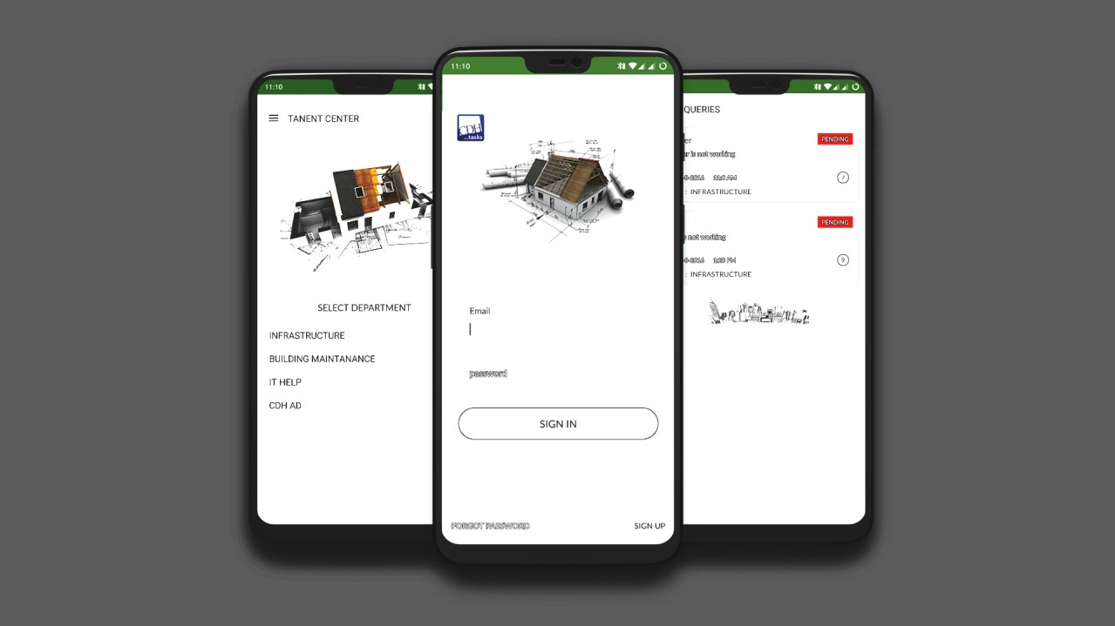

Slide 12
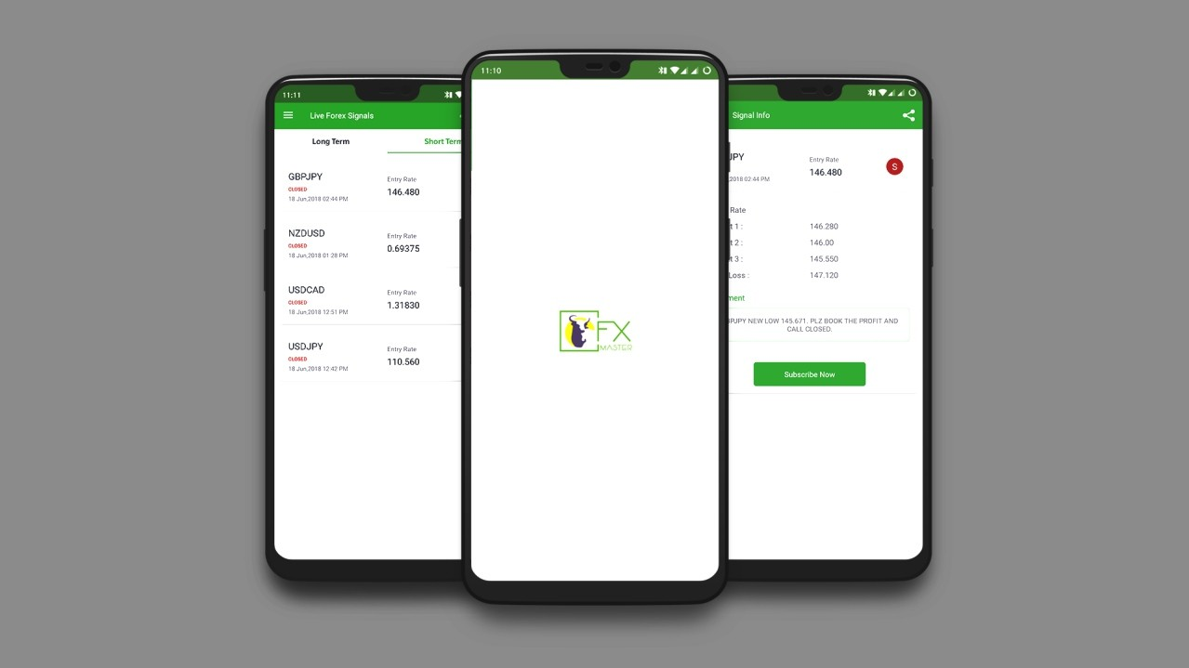

Slide 13
WEB DEVELOPMENT

Slide 14
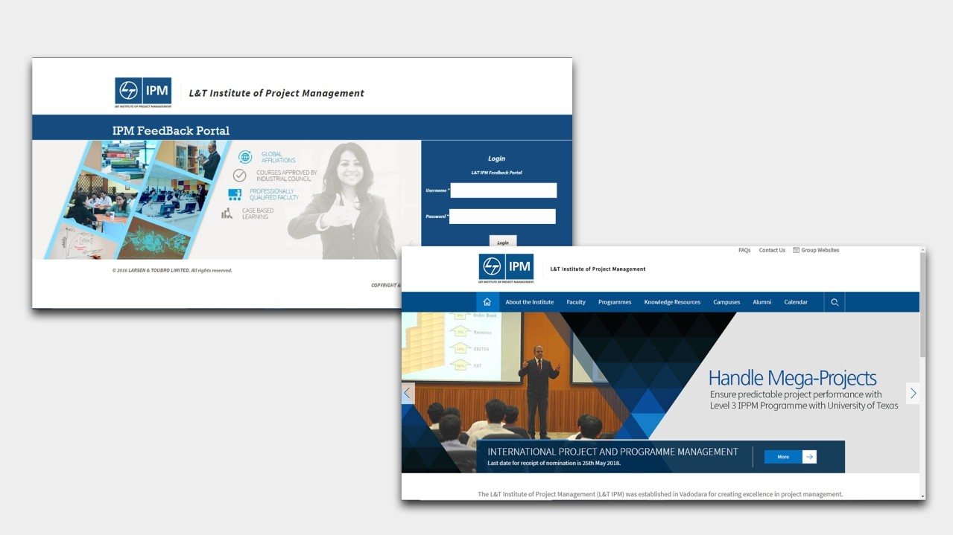

Customized portal for feedback management for L&T IPM Department.

Slide 15
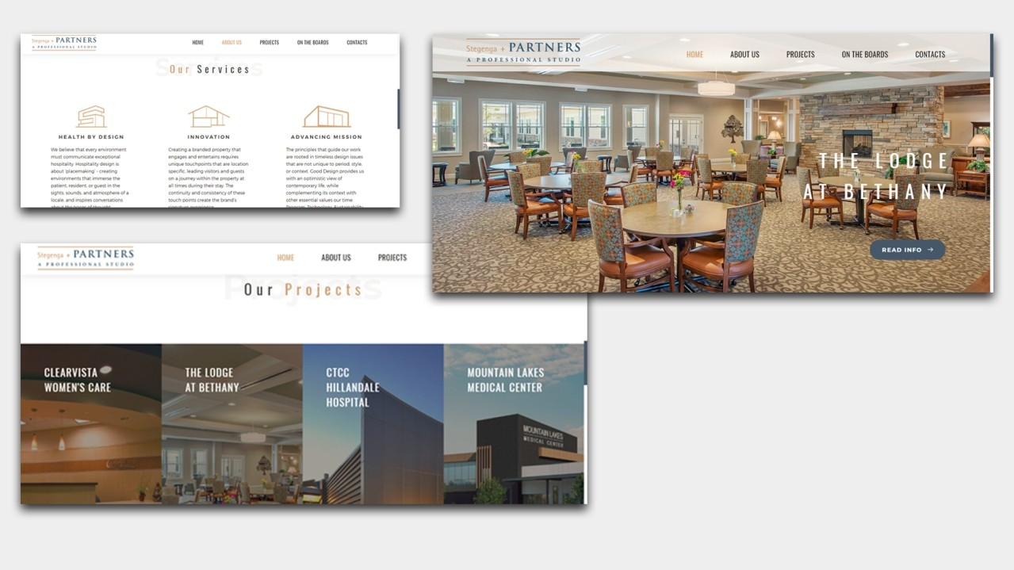




Stegenga + Partners create design solutions that connect a building’s purpose, function, and context; to engage, inspire, and enhance the human experience.
www.snp-studio.com

Slide 16
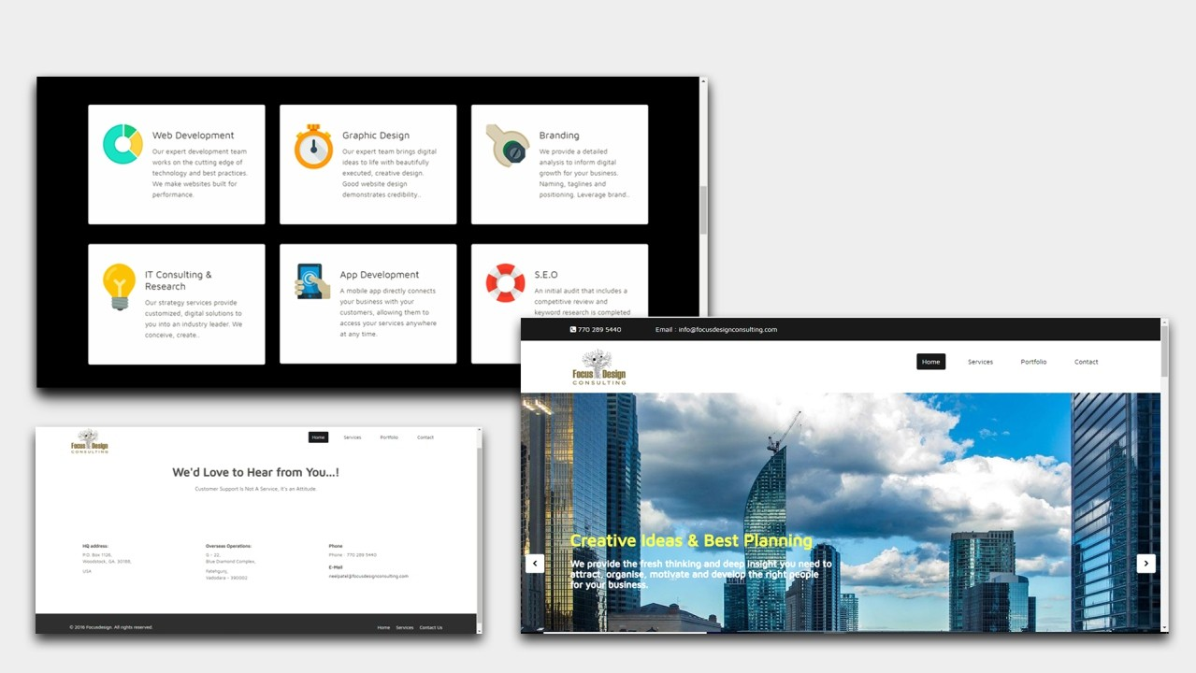



www.focusdesignconsulting.com
Focus Design Consulting provides support in Accounting, Book keeping, Financial and Budgetary control, Tax Planning, Marketing, Design, Software Development and Integration, Technology Infrastructure Design and Hosting, Hardware Support, Web Development, Web Control and Maintenance, Architect Design, Data analysis, Legal work, Security Oversight and Monitoring and other A d m i n i s t r a t i v e A c t i v i t i e s f o r C l i e n t s l o c a t e d On-site and Off-site.

Slide 17
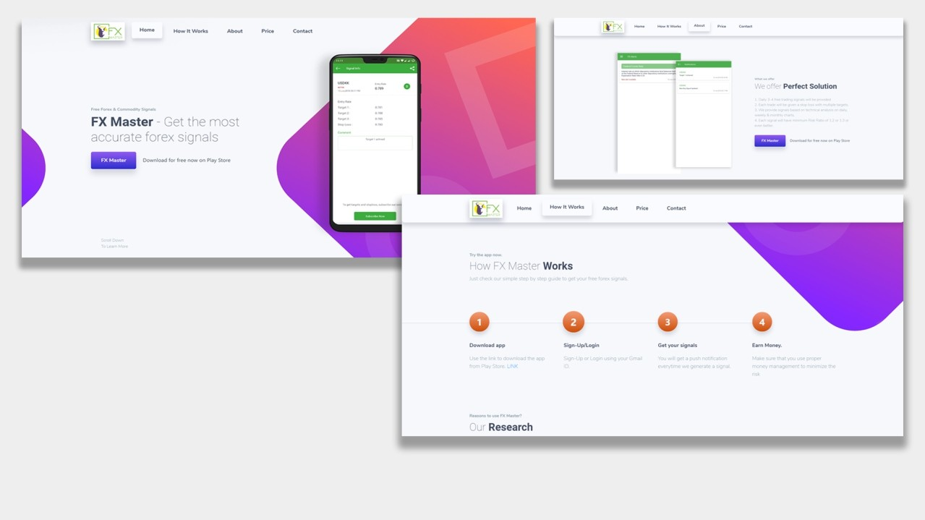




FX master is a forex trading analysis application platform which provides trading signals to susbcribers & app users.Kickstart Solutions developed the application & main internal features like techinical analysis, trend analysis & forex data collection setup.
www.fxmaster.in

Slide 18

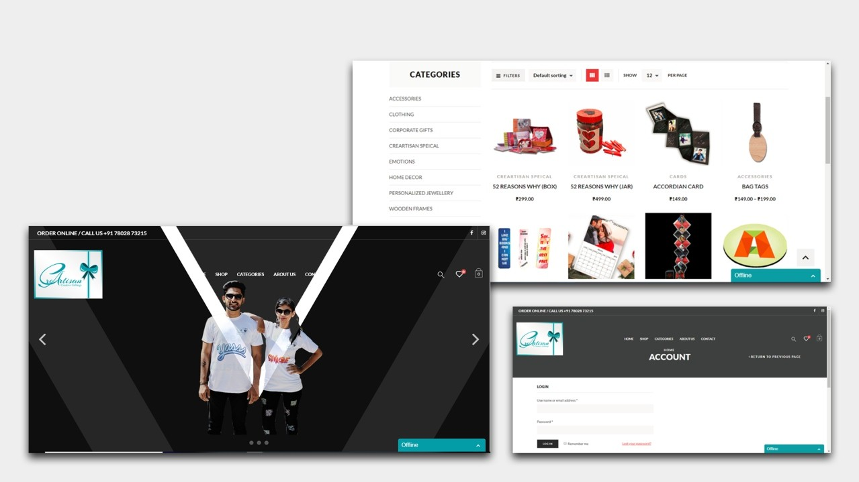


www.creartisan.com
Creartisan believes Creative Gifting is the best way to communicate the love & express gratitude. They handcraft each of our products to best convey your sentiments in the most beautiful way you could imagine!

Slide 19

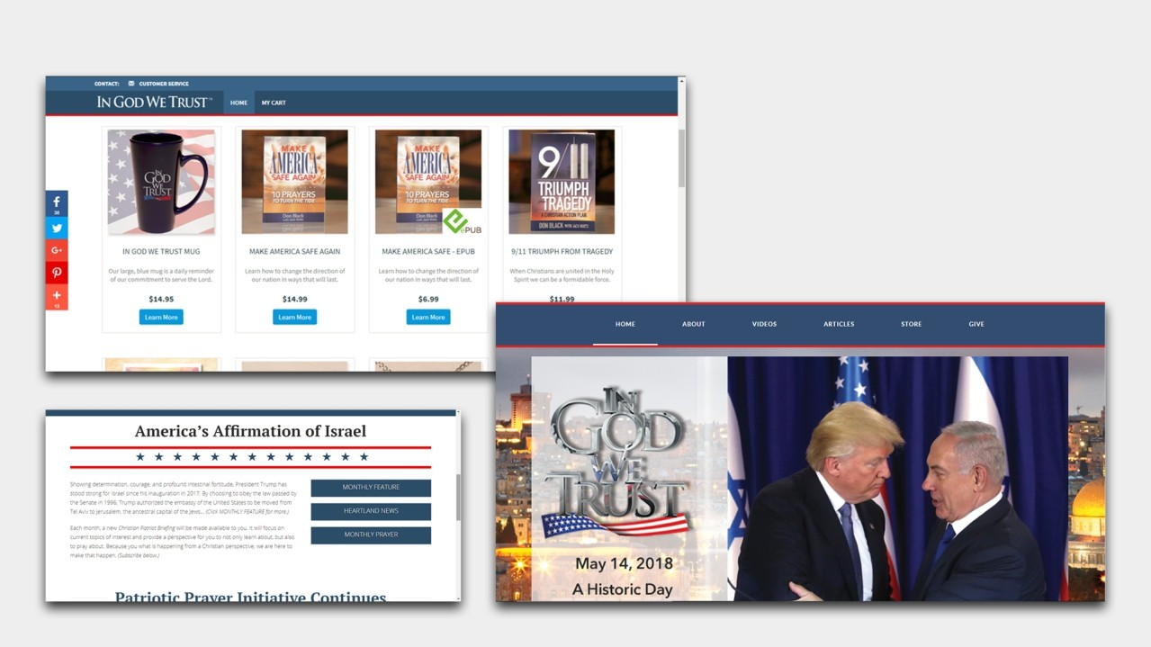


IN GOD WE TRUST exists for Christians like you—we want our voice to be heard, declaring that following God and Biblical principles should be the main priority for our nation!
www.ingodwetrust.tv

Slide 20
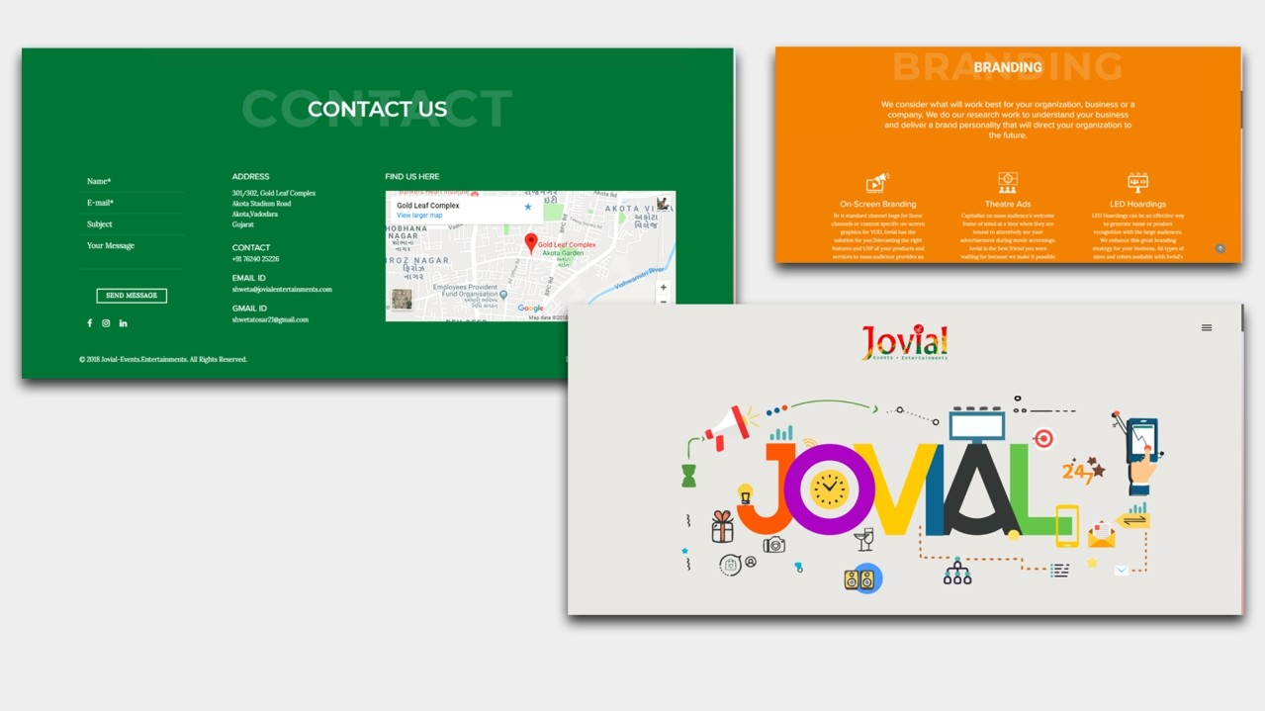




A perfect fusion of Event Management, Advertising, Marketing and Branding, all under one name:
Jovial – Events. Entertainments
jovialentertainments.com

Slide 21

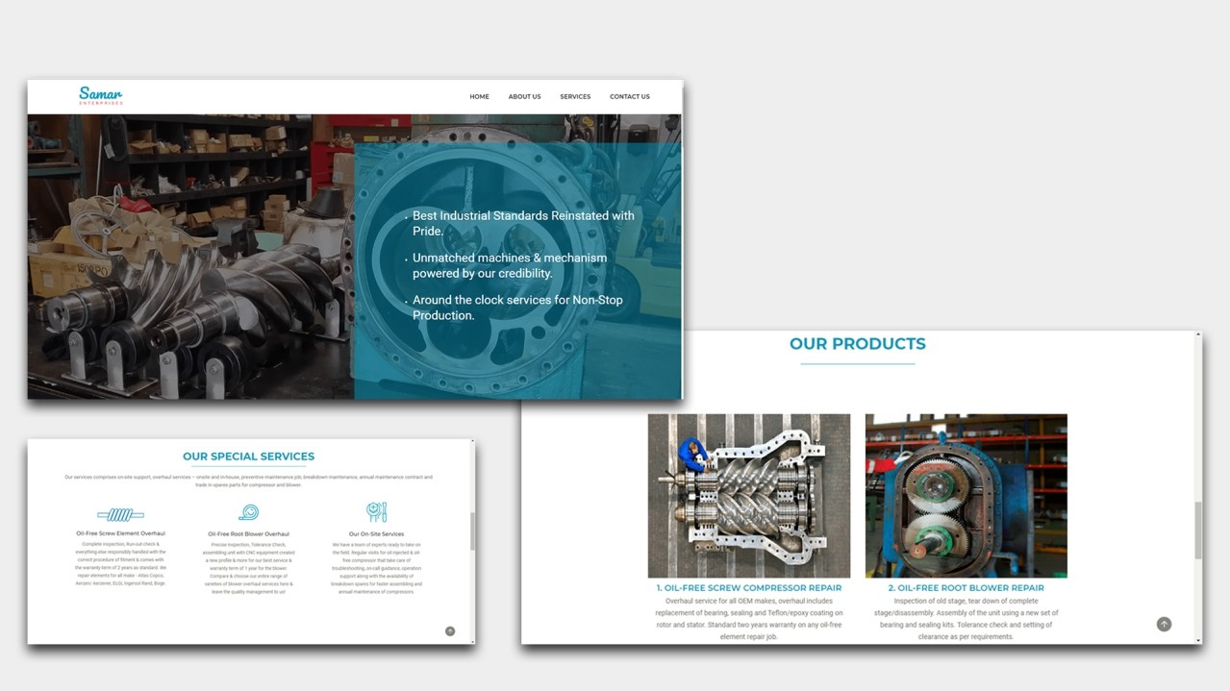


www.samarenterprises.co.in
Samar Enterprises a rm dealing in industrial oil-free screw compressor and oil-free root blower services. Our services comprise site support, overhaul services – onsite and in-house, preventive maintenance job, b r e a k d o w n m a i n t e n a n c e , a n n u a l m a i n t e n a n c e contract and trade in spares parts for compressor and blower.

Slide 22

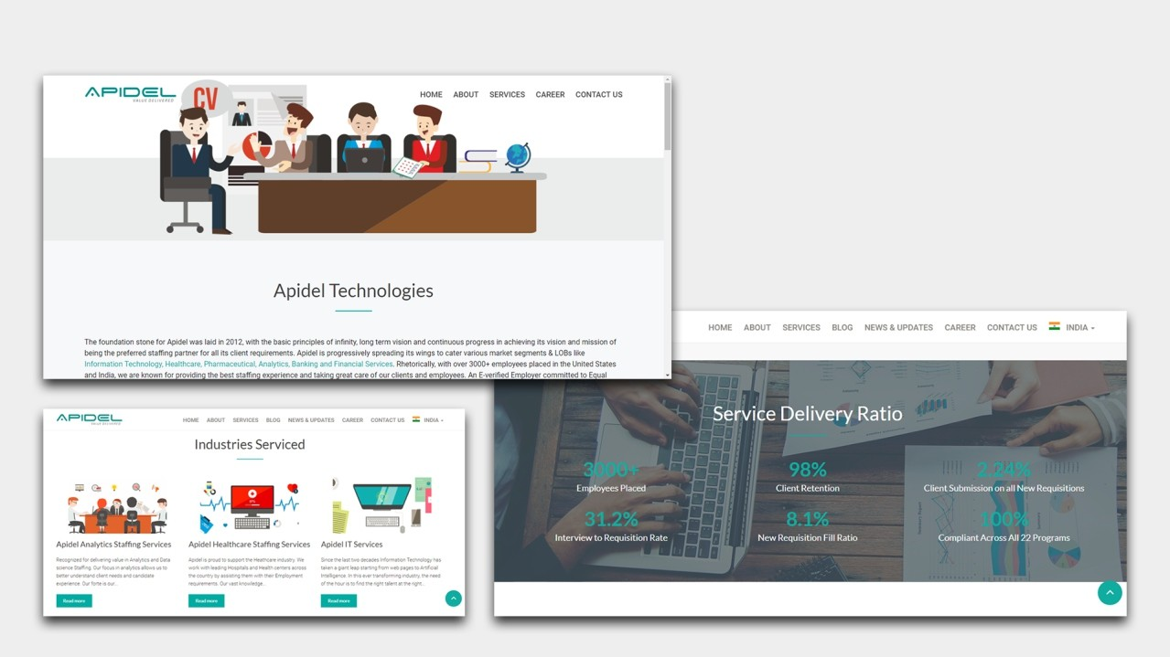

www.apidel.in
An E-veried Employer committed to Equal Employment Opportunity, Apidel is a team of technology and recruiters with expertise in various key industry domains such as IT, Healthcare, Pharmaceutical, Engineering, Analytics and BFSI.

Slide 23
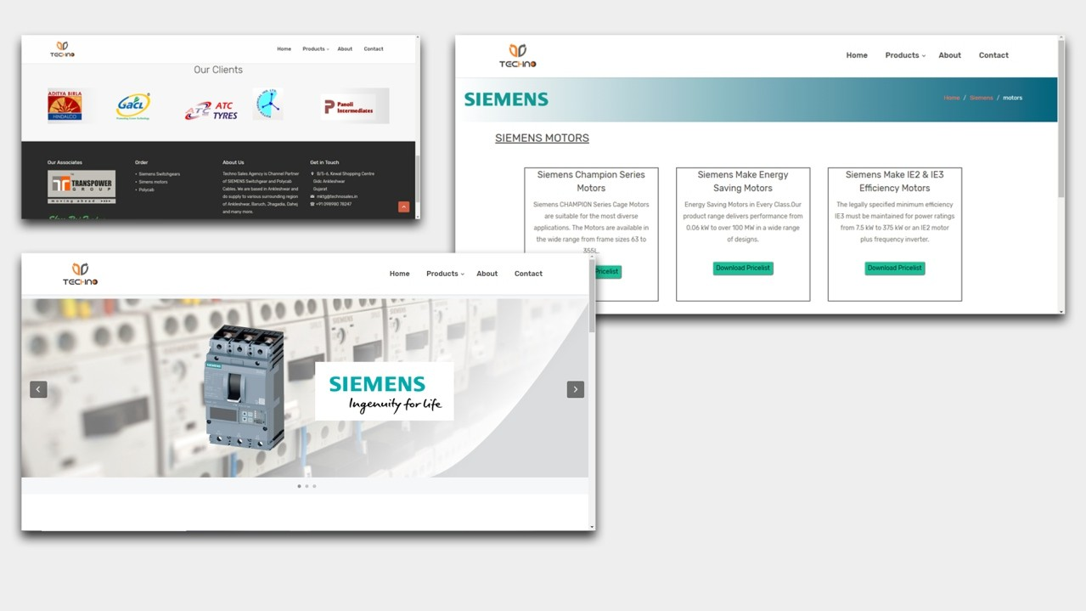


TECHNO is the Leading name since 3 Decades in Switchgears and Cables. The approach with Best Quality and Services to our Customers makes us Different. Techno Sales Agency is Channel Partner of SIEMENS Switchgear and Polycab Cables.
www.technosales.in

Slide 24


Banko Design is accomplished in designing senior living, multi-family, commercial and hospitality spaces, our team collaborates to deliver incredible interiors across all sectors.
bankodesign.com

Slide 25
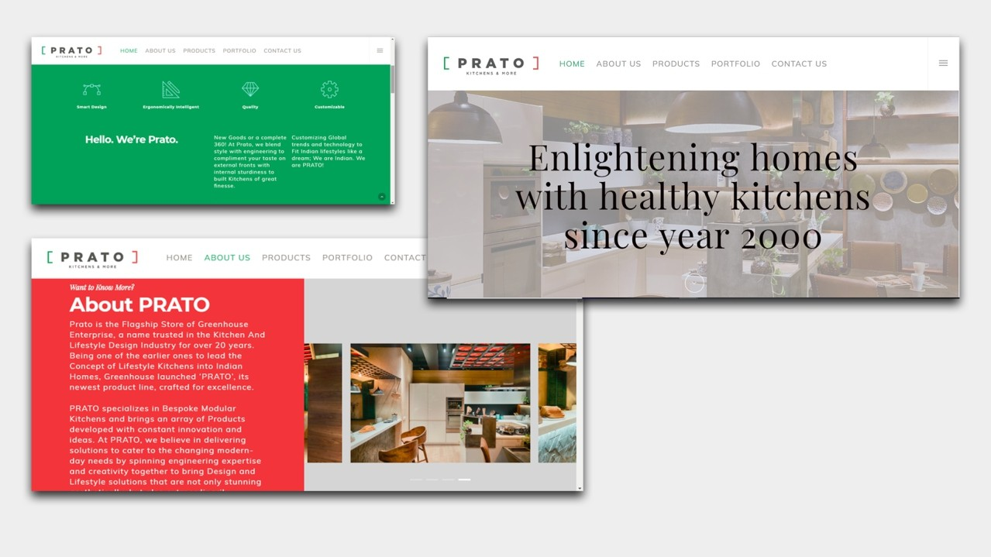


Prato is agship store of GreenHouse Enterprise. Prato is exclusive range of Bespoke Modular Kitchens dealing with high-end luxury lifestyle kitchen makeovers. We have taken
Prato's luxury quotient up a notch with managing their social media and website development & designing.
www.pratokitchens.com

Slide 26

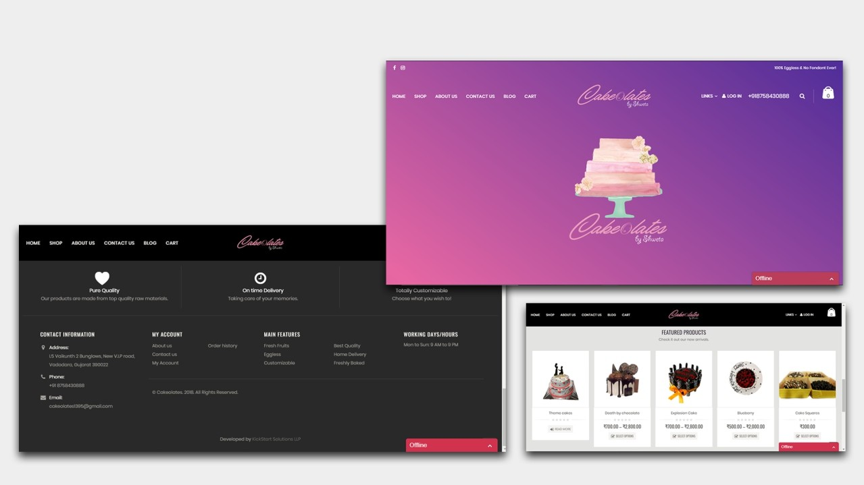


www.cakeolates.com
Managed and iced by Shweta, at Cakeolates every
avor has a story. Cakes are an expression of happiness, sweetness and love. Cakeolates started out as a hobby. Mentor and student – Mukta and Shweta explored their interest in baking. What started out as a hobby for passion is now slowly growing into a sweetness tradeshop.

Slide 27

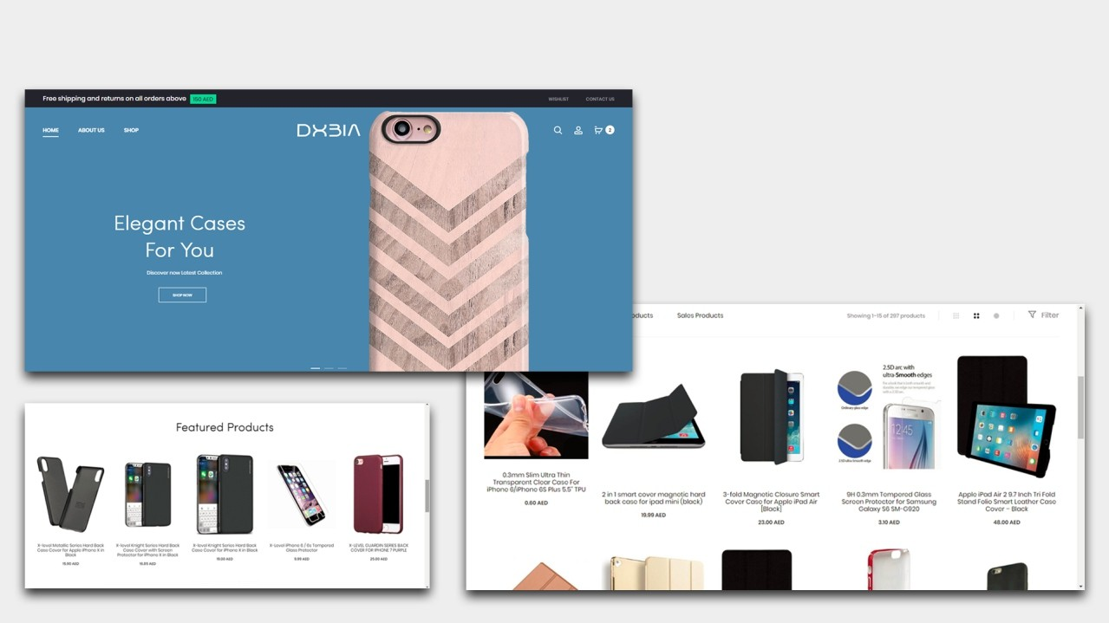


www.dxbia.com
DXBIA is Dubai based company dealing with mobile accessories and electronics. They wanted an e-commerce website which can compete with the larger
sh in market. KickStart Solutions has designed this website to reect the DXBIA philosophy - High Quality and Elegance in work.

Slide 28
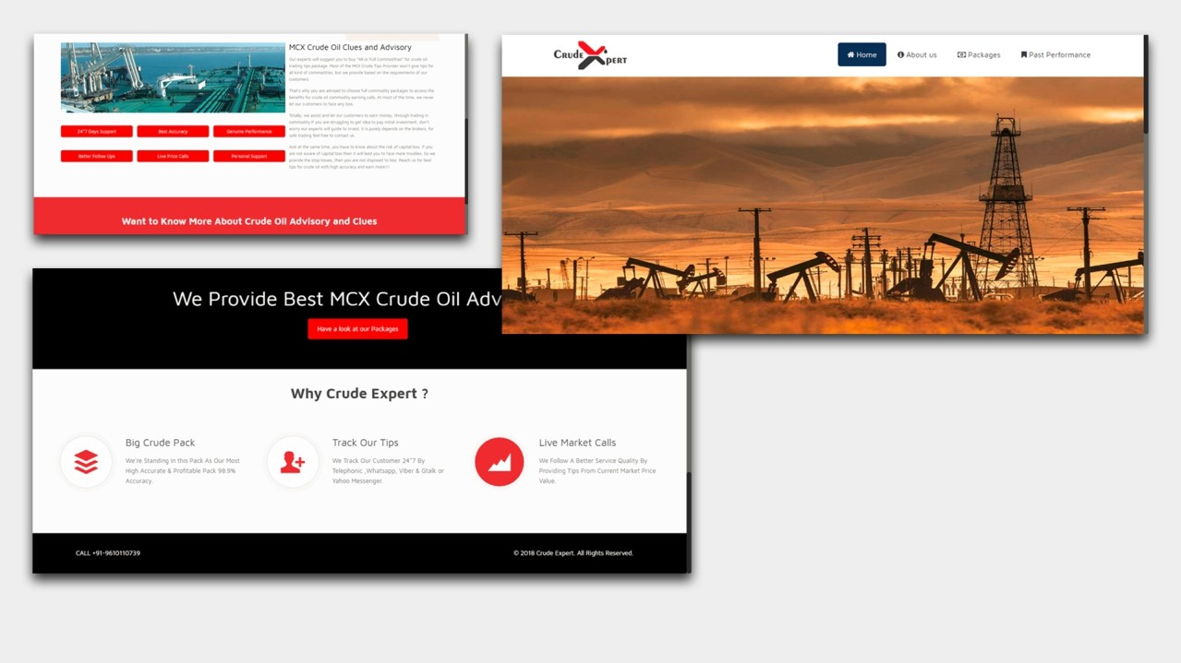



Crude support services – One of the reputed Crude Oil Tips provider updating the information in Commodity markets. They are the No.1 and fastest developing Crude support services organization in India & their valuable tips and calls assists the trader to earn money in the best way.
www.crudexperts.com

Slide 30

M:
| +91 95862 40012
KICKSTart
S o l u t i o n s L L P
Thank You !
Bhargav Shastri (Founder & Director)
Dwarkesh Business Solution
Mo: +91 96622 22272 | Skype: bhargavshastri |
LinkedIn: https://www.linkedin.com/in/bhargavshastri/
Email: info@dwarkeshit.com | bhargavshastri@Hotmail.com
Office: SF 207/208, Satva Avenue, Opp. Axis Bank, Sama-Savli Rd.
Vadodara 390005

